Slide 1
Decision Making
Theories and Models

Slide 2
Session Objectives
Discuss decisions from an advanced practice perspective
Consider the context of high level decision making
Explore theories of decision making
Applied models which support development of roles

Slide 3
Relevance of Decision Making
Clinical governance framework – quality healthcare
Public expectation
Accountability of professionals- self regulation, PDP, appraisal, performance
Processes that underpin the functionality of professional roles.

Slide 4
Within a Professional Role
Within a care context:
  Systematically assess patients
  Diagnoses
  Plan
  Implement
  Evaluate
Skills
  Judgement and decision making – effective with application of critical thinking

Slide 5
Decision Making
A choice between alternatives
Making independent decisions (Tiffen et al. 2014)
Freedom to exercise judgement about actions, in turn accepting responsibility for them and being held to account.

Slide 6
Reality of Decision Making
Problem solving
Critical thinking
Judgement
Evidence based practice
Reflective practice
Ethical imperatives
Professional accountability

Slide 7
High Level Decision Making
Making decisions autonomously which affect patient care
Taking account of various factors which have bearing on the outcome – high risk
Overlap between critical thinking and decision making in context
Judgements informed by information gathering from patients

Slide 8
Decision Making Needs
Practically and cognitively skilled practitioner
Assessing the effectiveness of approaches
Taking into account
  Experience/expertise
  Competence
  Knowledge
  Values and beliefs
Professional, legal and ethical drivers

Slide 9
Bounded Rationality
No one has the mental capacity to know everything
  Patterns and cues can reduce the amount of Raw knowledge which has to be retained
You can have every piece of relevant information and not be able to make a decision
  Knowledge/Data does not necessarily mean an effective decision will be made

Slide 10
Models of Decision Making
Classification (Bell et al. 1995)
Normative
  Rational, logical, scientific evidence
  Empirical evidence, population based studies
Prescriptive
  Improved decision making utilising frameworks, algorithms and guidelines
  Decision support, guides systematic problem solving
Descriptive
  How ‘real life’ decisions are made
  Novice to expert theory (Benner, 1984)

Slide 11
Novice or Expert?
How does an expert make decisions?
  Increase use of intuition, patterns, quick decisions
  Reduced neural taxation
How does a novice make decisions?
  Slow decision making
  Use of multiple tests, observations and data
  Mentally tiring
(Benner, 1984)

Slide 12
Theories of Decision Making
Information Process Theory
  Hypothetico-deductive
Intuitive-Heuristic Theory
Cognitive Continuum Theory

Slide 13
Dual Process Theory
Dual Process approach
Common approach in healthcare
• Rationalistic approach
A reasoning process, formulating a hypothesis and using research to arrive at a decision
  (Elstein et al 1978)

Slide 14
Information Processing
Pattern acquisition or recognition
  Preliminary information gathered
  Structured history taking and assessment
  Physical examination, diagnostic tests
  Working diagnosis, exclusion of red flags
  Consultation and examinations skills paramount
Hypothesis generation
  Initial/tentative hypothesis generated
  Findings from examination/testing
  Narrowing of possibilities
  Indications of urgency, eliminate red flags; act accordingly

Slide 15
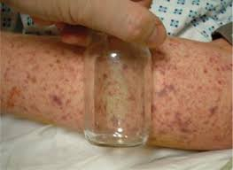

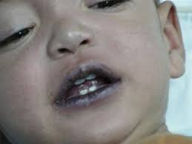
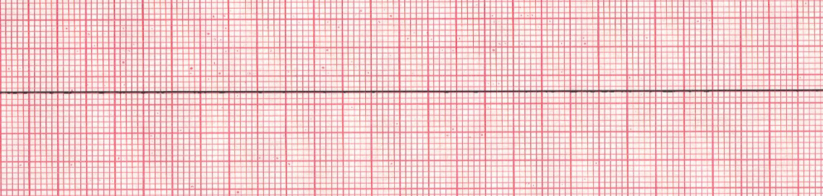
Intuition – A Time and a Place
Pattern Recognition – Emergency Situations

Slide 16
Intuitive-Heuristic Theory
Intuitive basis for decision making
  Understanding without rationale (Benner & Tanner, 1987)
Information void
  experience is vital to the decision making process
Situational
  effective in some circumstances

Slide 17
Information Processing
Cue acquisition or recognition
  Involves interpreting the information gathered and initial cue acquisition phase
  Contribute to, confirm or exclude initial hypothesis
  Likely diagnosis ‘what is going on here’
Hypothesis generation
  Involves evaluation evidence and weighing up pros and cons, either confirming or rejecting the initial diagnosis (Tiffen et al, 2014)

Slide 18
Heuristics
Heuristics can be mental shortcuts that ease the cognitive load of making a decision.
Examples that employ heuristics include using a rule of thumb, an educated guess, an intuitive judgment, a guesstimate, profiling, or common sense.

Slide 19
Intuitive-Heuristic Theory
Application of theory
  Complex presentations with high level of uncertainty or when assessment required in rapid time frame
    Encourages critic thinking for novices and experts
Limitations
  Not a linear process
  Knowledge and experience required to investigate al cues
  Clinical acumen vs rule of logic (Croskerry, 2000)
  Liable to confirmation bias
Cautions
  Reliance on intuition alone, not sufficient for robust decision making
  High risk and prone to error
  Experience doesn't always equate with expertise.
Experts differ from novices in decision making

Slide 20
How do Higher Level Clinicians make decisions?
Take the history
Intuition
Focused questions and testing
Questioning until able to make a decision
Not to reach a formal or final diagnosis
Top down thinking

Slide 21
Cognitive Continuum Theory
Decision making can be:
  Poorly structured, little time, multiple cues – Intuitive
  Well structured, allowed time, few cues – Rational
In reality; Somewhere in between
System aided by judgement – prescriptive model
CCT tool aids transparency (Calder et al. 2005)

Slide 22
Cognitive Continuum Theory
No single theory prevails
Neither purely rational or intuitive, lying along a continuum.
Purely intuitive to purely rational (Shaban, 2012)
Prescriptive and descriptive model

Slide 23
Cognitive Continuum Theory
Central Tenet
The way the task is approached
  Complexity – number of information cues required
  Ambiguity – task characteristics that introduce information processing
  Presentation
    Time frame
      Restricted time likely to draw on intuitive approach
      More time resulting in deconstructing the task leading to rational approach
      (Thomson et al, 2015)

Slide 24
Summary
Decision making is integral to high quality care delivery – nature and context of practice – often complex; risk prone; inclusion of biases.
Knowledge of theories assist in raising awareness of strengths and limitations of different theories
Application – context within which healthcare is delivered in practice, influencing decision making.

Slide 25
References
BENNER, P. 1984. From novice to expert. Addison-Wesley. Menlo Park , CA
BENNER, P. and TANNER, C. 1987. Clinical judgement: how expert nurses use intuition. American journal of nursing. 81 (1), 23-31.
BELL, D., RAIFFA, H. and TVERSKY, A. 1995. Descriptive, normative and prescriptive interactions in decision making. In Decision making . Cambridge University Press. Cambridge.
CALDER, R., CAMPBELL, S. and WATSON, D. 2005. Cognitive continuum theory in nursing decision making. Journal of advanced nursing. 49 (4), 397-405.
CROSKERRY, P., 2000. The cognitive imperative thinking about how we think. Academic Emergency Medicine, 7(11), 1223-1231.
TIFFEN, J., CORBRIDGE, S. and SLIMMER, L., 2014. Enhancing clinical decision making: development of a contiguous definition and conceptual framework. Journal of professional nursing, 30(5), 99-405.
SHABAN, R., 2015. Theories of clinical judgment and decision-making: A review of the theoretical literature. Australasian Journal of Paramedicine, 3(1).
THOMPSON, C., CULLUM, N., McCAUGHAN, D., SHELDON, T. and RAYNOR, P. 2004. Nurses, information use, and clinical decision making—the real world potential for evidence-based decisions in nursing. Evidence-Based Nursing, 7(3), pp.68-72

